Slide 1
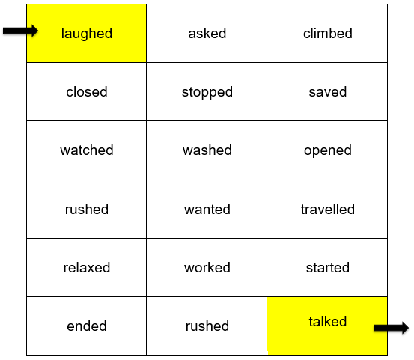
Can you find your way through the maze from the yellow rectangle at the top to the yellow rectangle at the bottom?
To help you get there, look for all the words that have the /t/ sound at the end of the past participles.
You can go up (↑), down (↓), left (←), and right (→) but you can’t go diagonally!

